Slide 1
Bluetooth receiver
Prof: Dr. Kiaei
TA: Vincent Chuang

Slide 2
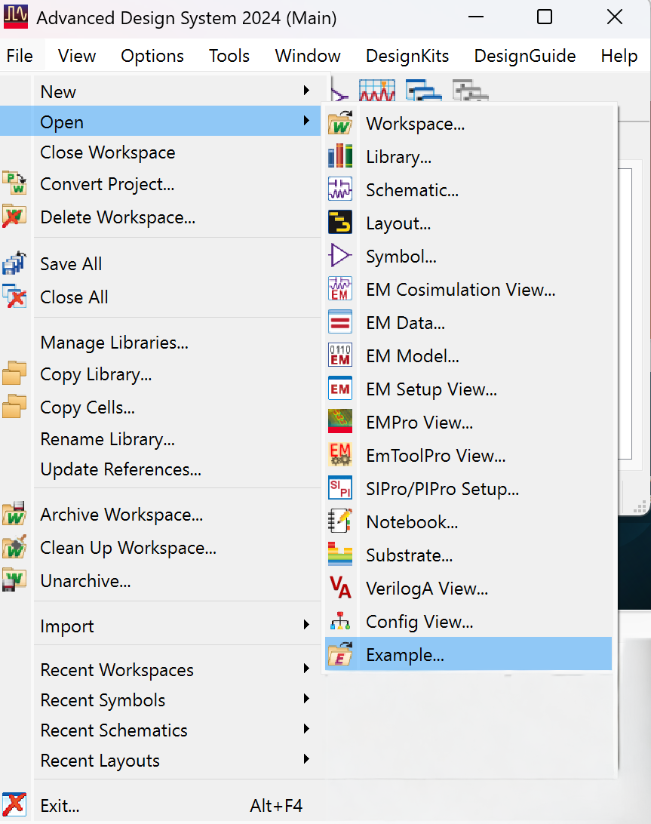
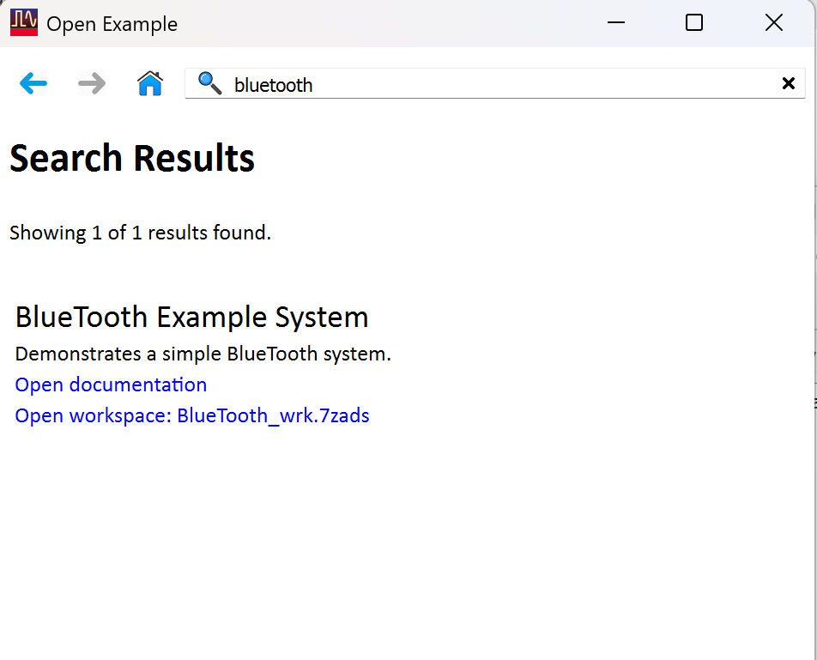
To start with this project
Go to ADS main window (2024) > Open > Example
Search “Bluetooth” > Open workspace

Slide 3
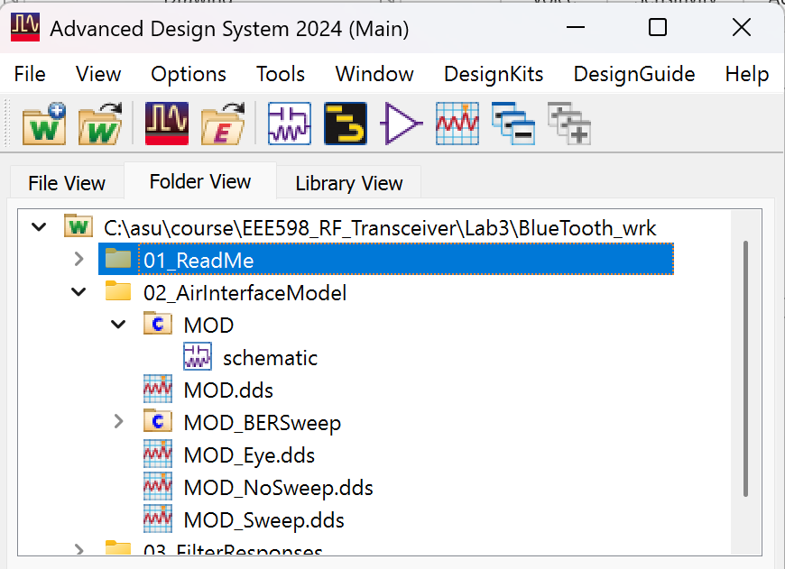
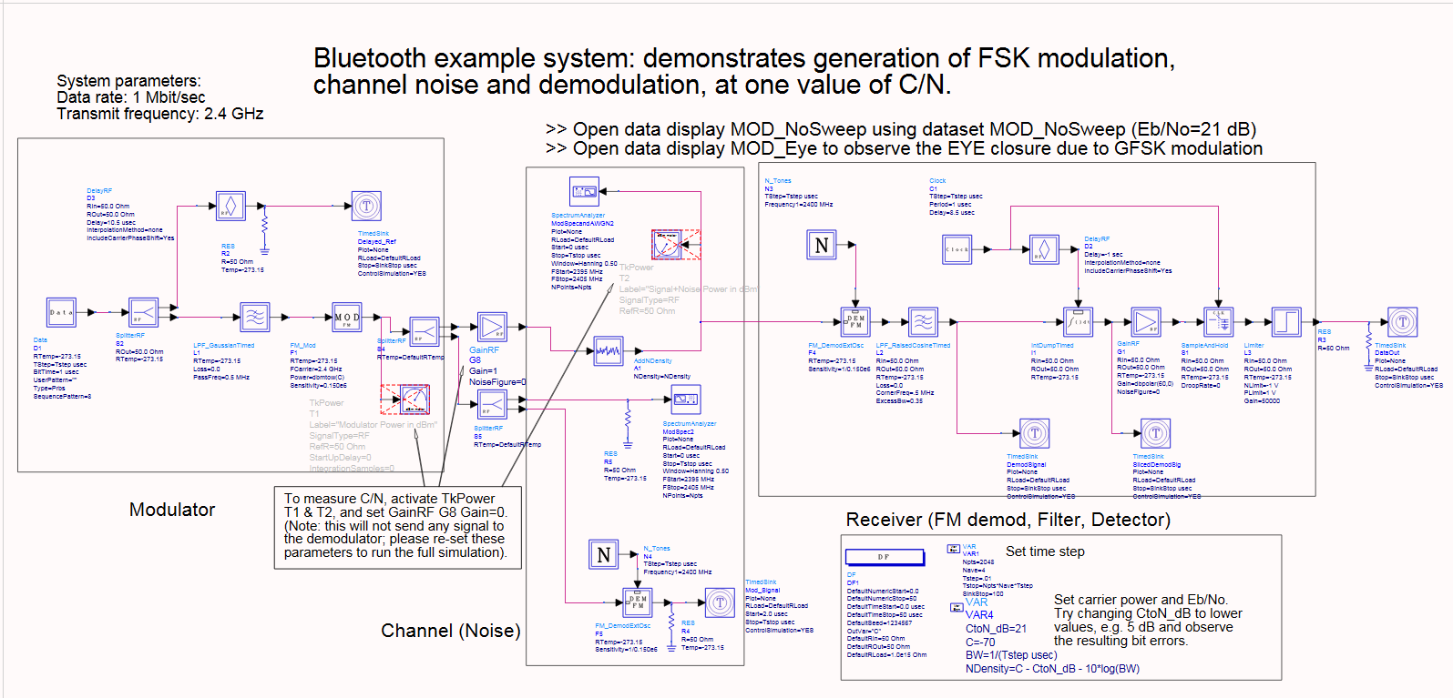
To start with this project
Open the schematic under the MOD folder

Slide 4
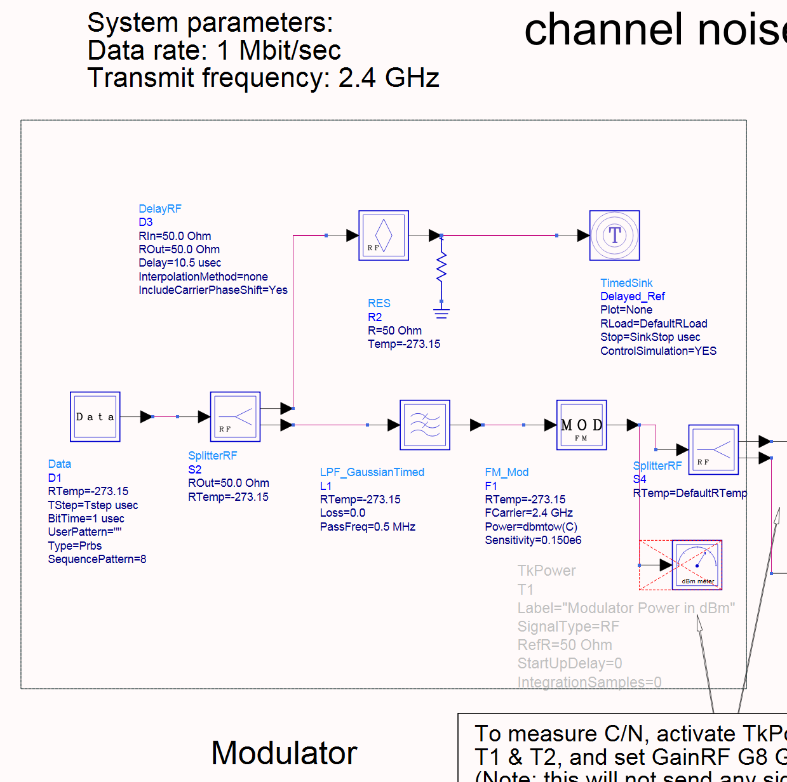
Transmitted signal generation
Data block:
Generate the random data composed of -1 and 1, which represents bit0 and bit1, respectively.
Tstep should be 1ns or less
Bit time = 1us (Bit rate = 1MHz)

Slide 5
Transmitted signal generation
LPF_GaussianTimed block:
Purpose: Make the transition between bit0 and bit1 smoother, reducing the variation in the spectrum.
Pass frequency = BT x bit rate = 500k
Bit rate = 1MHz in this project
BT = Bandwidth Time product = 0.5,
defined by the official Bluetooth handbook

Slide 6
Transmitted signal generation
FM_Mod block:
Purpose: Transform the input signal into the desired signal frequency and combine it with the carrier frequency.
Sensitivity = Channel width x h /2 = 140k
(h = modulation index = 0.24~0.35)
defined by the official Bluetooth handbook
(Channel width = 1MHz)
Fcarrier = 2.4XX GHz
(The last two digits are the last two digits of your ASUID)

Slide 7
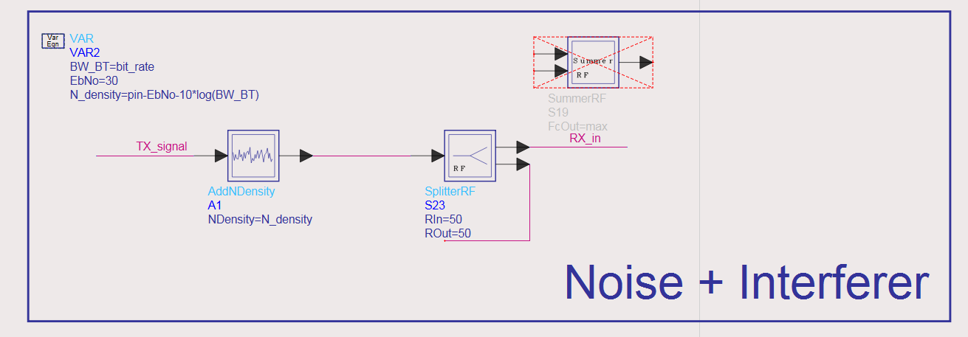
Adding noise, blockers, and interferers
AddNDensity block:
Purpose: To add noise and define EbNo (SNR)

Slide 8
Adding noise, blockers, and interferers
SummerRF block:
Purpose: To define the frequency and amplitude of the interferers and blockers.

Slide 9
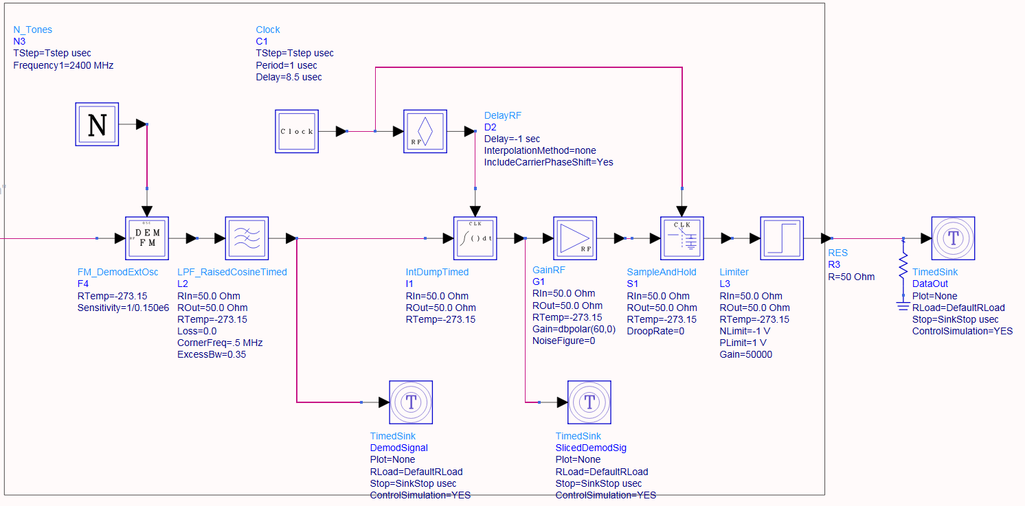
Bluetooth receiver structure
Note: In the example, a resistor is placed at the output.
Please remove it, as analog components are not available in the DF simulation.
If you need a resistor, please set Rload to 50ohm in the Timedsink block

Slide 10
Bluetooth receiver structure
FM_DemodExtOsc block:
Purpose: To demodulate the signal. The output waveform of this block is basically like the original data.
Sensitivity = 1 / (the sensitivity set in the modulator block)

Slide 11
Bluetooth receiver structure
N_Tones block:
Purpose: To provide the center frequency for FM_DemodExtOsc
Frequency = 2.4XX GHz
(Your ASUID)

Slide 12
Bluetooth receiver structure
LPF_RaisedCosineTimed:
Purpose: To filter out the out-of-band noise
CornerFreq = The pass frequency you set in the LPF_GaussianTimed block

Slide 13
Bluetooth receiver structure
IntDumpTimed:
Purpose: To assist in decision-making. The idea is to integrate over one bit period, then reset to zero, and repeat the process. If the value is greater than zero, it is bit 1; otherwise, it is bit 0.

Slide 14
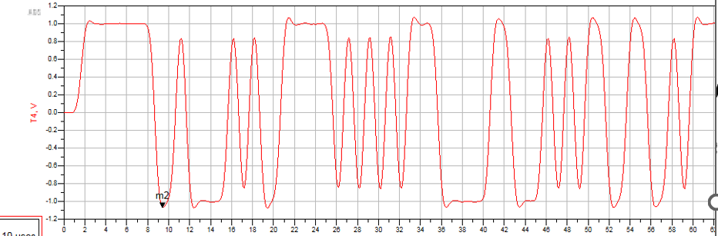
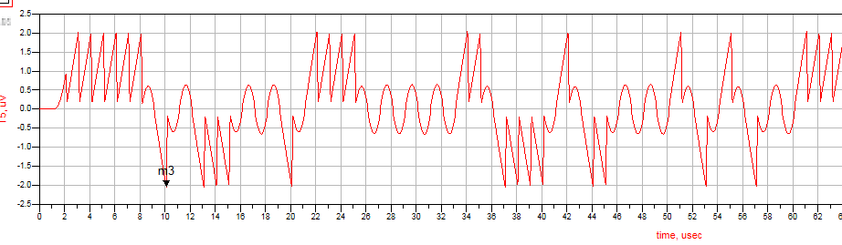
Bluetooth receiver structure
IntDumpTimed:
Since the transition from bit 0 to bit 1 is gradual rather than instantaneous, directly determining the sign at a single point may lead to incorrect decisions. By integrating over one bit period, the entire transition is accumulated, which improves the robustness in distinguishing between bit 0 and bit 1.
After integration

Slide 15
Bluetooth receiver structure
Clock:
Purpose: To sample the input signal properly.
Period = bit time (1us)
Delay: It’s ok to set it to 0 sec

Slide 16
Bluetooth receiver structure
DelayRF:
Purpose: To ensure the sample-and-hold timing occurs at the correct moment by delaying the signal.
We can delete it in this project.

Slide 17
Bluetooth receiver structure
GainRF:
Purpose: To amplify the signal to 1Vpp.

Slide 18
Bluetooth receiver structure
SampleAndHold:
Purpose: To sample and hold the signal

Slide 19
Bluetooth receiver structure
Limiter:
Purpose: If the signal is greater than zero, it outputs 1; otherwise, it outputs -1.
Gain: Set to it a large value
(=1000000)
SampleAndHold + Limiter
= 1bit ADC

